Slide 1

Spring Best Practices
Notes:
Just into on why we’re here today and what’s the point of having this presentation. Brifely touch the topic of presenters: SZ, OZ, IL, and KK.
In the end: passing the floot to Sviatlana.

Slide 2

Light talk authors
Jose Barros,
Senior Software Developer

Slide 3
Agenda
Motivations, why Spring best practices
Project structure
Do’s and don’t
Unit testing practices
Other topics

Slide 4
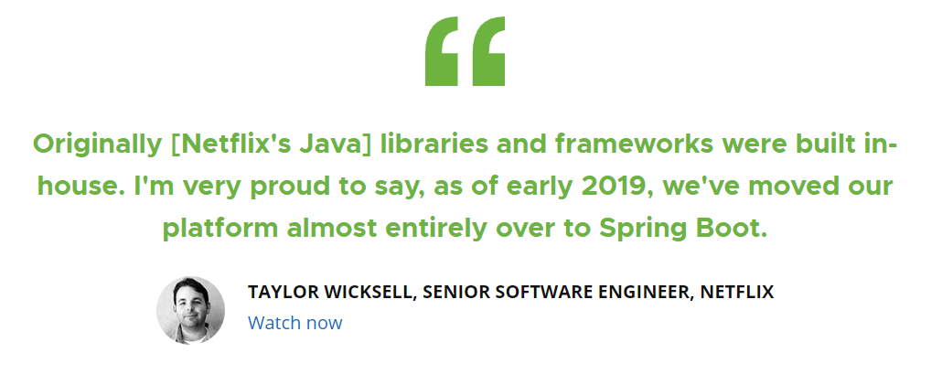
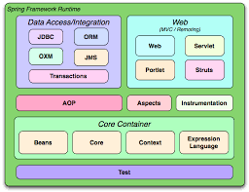
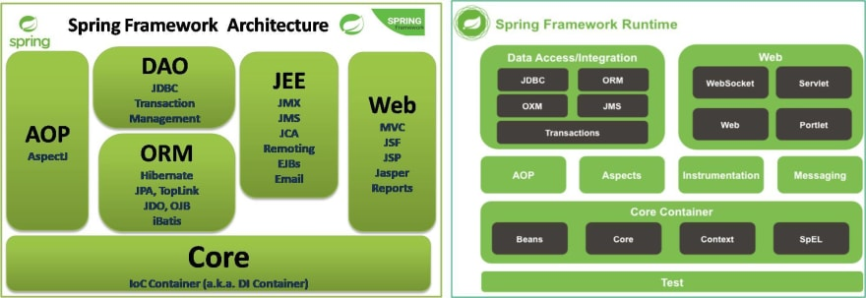
About Spring Framework
Spring makes programming Java quicker easier and safer.
Focus on speed, simplicity and productivity.
One of the world’s most popular java framework, 40% of apps uses Spring boot and 36% Spring MVC. (JVM Ecosystem report 2018 - About your Platform and Application | Snyk)

Slide 5
IOC inversion of control
Dependency injection helps project organization, tests and overall code quality.
Reduces noise in your code
Reduces object coupling
Reduces defects that arise from incorrect construction
Focus on the API contract

Slide 6
How to structure a project
Folder organization
Dependencies management
Java config vs XML config
Properties file

Slide 7
Java Configuration
Native language syntax
Compile time checking of configuration
Easier IDE integration

Slide 8
References
Spring Framework Architecture and Runtime Components - DEV Community
Building blocks of Spring (linkedin.com)
JVM Ecosystem report 2018 - About your Platform and Application | Snyk
Spring | Home
Taylor Wicksell and Tom Gianos at SpringOne Platform 2019 - YouTube

